Slide 1
Chapter Quiz
Coding and Programming

Slide 2
Quiz
Chapter 3
For Student
ⓒ2023 SAMSUNG. All rights reserved.
Samsung Electronics Corporate Citizenship Office holds the copyright of this document.
This document is a literary property protected by copyright law so reprint and reproduction without permission are prohibited.
To use this document other than the curriculum of Samsung innovation Campus, you must receive written consent from copyright holder.

Slide 3
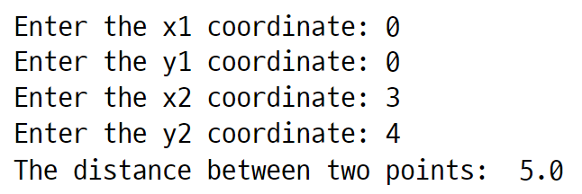
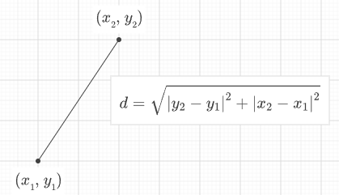
UNIT 17
Function
Q. 17-01
Receive the coordinates (x1, y1), (x2, y2) of two points from the user and print the distance between the two points as follows. To do this, implement the distance(x1, y1, x2, y2) function.
Coding guideline: Refer to the figure below for the formula to find the distance between two points.

Slide 4
UNIT 18
Recursion Function Call
Q. 18-01
A palindrome is a sentence, word, or string that is the same as reading any character from back to front. Words like level, eve, and radar are examples of the palindrome.
Let's use a recursive call to determine a palindrome. Define a function called is_palindrome and write a program that receives a string from the user and prints whether the string is a palindrome or not.
Coding guideline: Call the is_palindrome function inside the is_palindrome function.

Slide 5

UNIT 19
Lambda
Q. 19-01
There is a list named n_list with values of [10, 20, 30]. Write a code that puts n_list into the map function and returns the result as follows.
Coding guideline: Use the map and lambda functions.

Slide 6
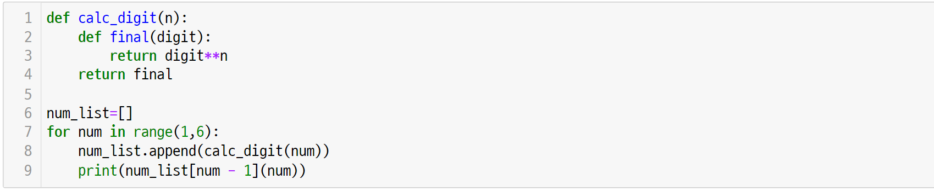
UNIT 20
Closure
Q. 20-01
In the following code, expect what value will finally be included in num_list. Calculate the expected result by hand.
Coding guideline: Through the for statement, the output will be printed 5 times. Expect this output and write the result.

Slide 7

UNIT 21
Class
Q. 21-01
Implement multiplication (*) and division (/) of two vectors using the mul and truediv methods learned in unit 21. Assuming that v1 is (30, 40) and v2 is (10, 20), write a code that prints the output as below as the result of the multiplication and division of two vectors.
Coding guideline: Write a code that extends the functionality of the Vector2D class you learned in this chapter.

